Slide 1
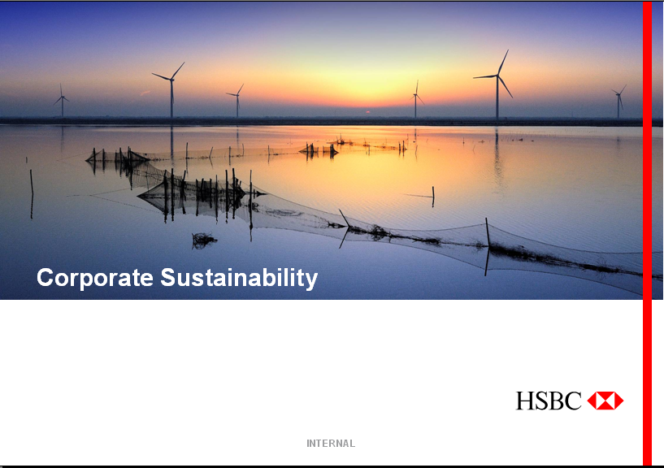
Project Miracle Presentation
Miracle Team @ Innovation Competition 2017
Teammates: Fergie, Prin, Zeno, Wennius, Snowy
INTERNAL

Slide 2


Slide 3


Project Introduction
We would like to implement a Personal Banking Voice Assistant which is targeted for elderly users to manage their monetary stored in the bank (balance/transaction history query, account transfer, etc), the elderly users is not accustomed to complex UI on smart phone and prefer talking with bank tellers. This App saves their time to go to the branch for the banking service.
Features for the APP:
Logon with biometric technology such as fingerprint.
Support balance inquiry.
Support transaction history inquiry.
Support small account transferring.
Open Applet of Wechat to use this APP, don’t need to install it, easy for usage.
Voice Assistant
Every operations are in voice
Portable Teller
Personal bank teller in your hand

Slide 4

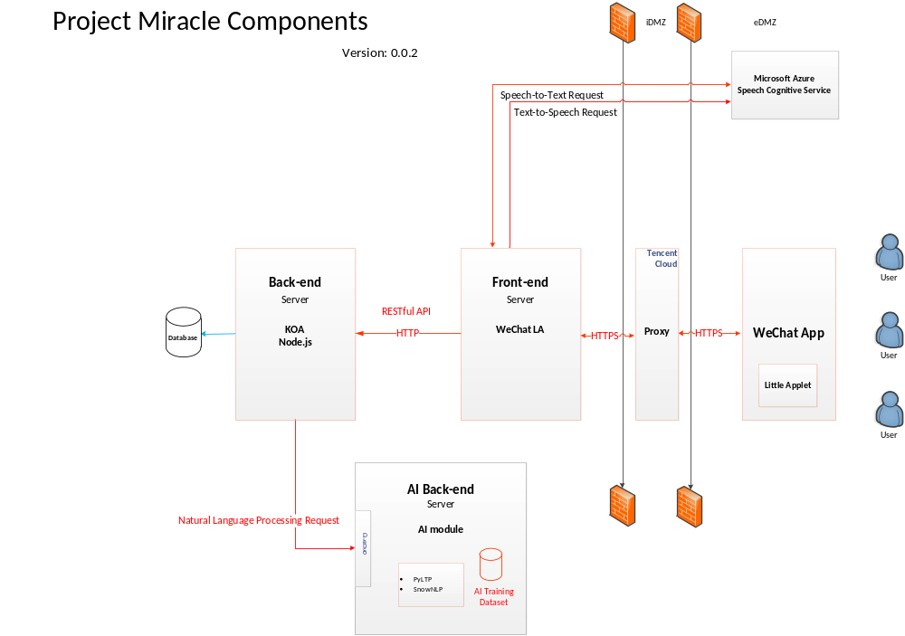
Notes:
汇丰碳融资策略？——投资促进低碳经济

Slide 5









Technology Stacks of Miracle Team
Our team will make use of the following technology stacks:
Front-end
Back-end
Artificial Intelligence

Slide 6
Outlook
Logon with biometric technology such as face recognition
Report the loss of debit card
Provide the consumption reminds
Provide the monthly summary report / yearly summary report
Open account for fixed time deposit.
Query, buy or cancel on the financial products.
Support more kinds of language.
Can install in any device, e.g. computer, smart phone (Android, iOS), pad, watch or any device which connect internet via WiFi, accept the voice instruction and can speak out the result.

Slide 7


Slide 8


Design Doc: https://github.com/ProjectMiracle/Design
Front End Source Code: https://github.com/ProjectMiracle/FEA
Back End Source Code: https://github.com/ProjectMiracle/BE

Slide 9


